Slide 1

Textron Cooling Fan Monitor Circuit Board
By: Ayham Sabra, Cody White, and Melvin Stjohn

Slide 2
General information
We will be building a fan monitor system that will ground undesired input
These circuit board will have to follow restrictions: DO-160G section 6, 8 and 22
No programmable parts
Should fit inside a 0.5 inch x 0.5 inch x 1.5 inches
What will be sent to Textron is PCB schematic files, PCB layout files and package design files. A report will also be written detailing functional description, how to test parameters, and testing results.

Slide 3
Timeline
Date | Objective | Date | Objective
10/1 | Initial research | 2/11/2022 | Begin shrinking of circuit board size in prototype. With PCB layout
10/22 | Simulation prototype complete | 2/25 | Initial protypes
10/29 | Initial large working prototype built | 3/4 | Tests
11/5 | Second prototype simulated that will be more compact | 3/25 | Final protype, Packaged. Send to Textron with report
Winter break | ------------------------------- | 4/1 | Everything should be finalized by now

Slide 4
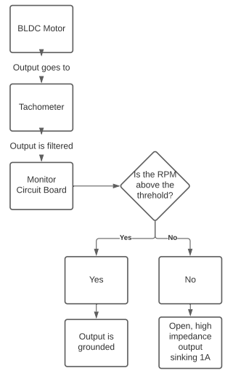
Block Diagram

Slide 5
Questions
What are the constraints of the DO-160G testing that we are required to pass?
Will Textron do these tests? If not, how frequently will they allow us to test?
How will we test for the given temperature and altitude requirements?
Pressure chamber testing required?
What software are the deliverables to be in?
What level of precision? Dead band?
Magnetic shielding?
Is there a need for redundancy?

Slide 6
Questions cont.
Can Textron provide a test motor, or characteristics thereof?
No programmable components. Are logic gates acceptable?
Is there a process, or contact, to acquire materials?

